Slide 1
Chapter 2
Command line editing

Slide 2
CONTENT
01
03
Enabling Command-Line Editing
vi Editing Mode
02
04
The History List
The fc Command

Slide 3
CONTENT
05
07
History Expansion
Keyboard Habits
06
readline

Slide 4
Enabling Command Line Editing
bash initially starts interactively with emacs-mode as the default.
To switch to another editing mode, the set command is used.
set -o emacs
or
set -o vi
The main purpose of command line editors is to let you transfer “keyboardhabits” from your favorite editor to the shell.
fc is quite a powerful facility in this regard as it is mainly meant to supplant C shell history and as an “escape hatch” for users of editors other than vi or emacs.

Slide 5
The History List
Whenever you log in or start another interactive shell bash reads an initial history list from the .bash_history file in your home directory.
When you exit a shell bash saves the list of commands in .bash_history.

Slide 6
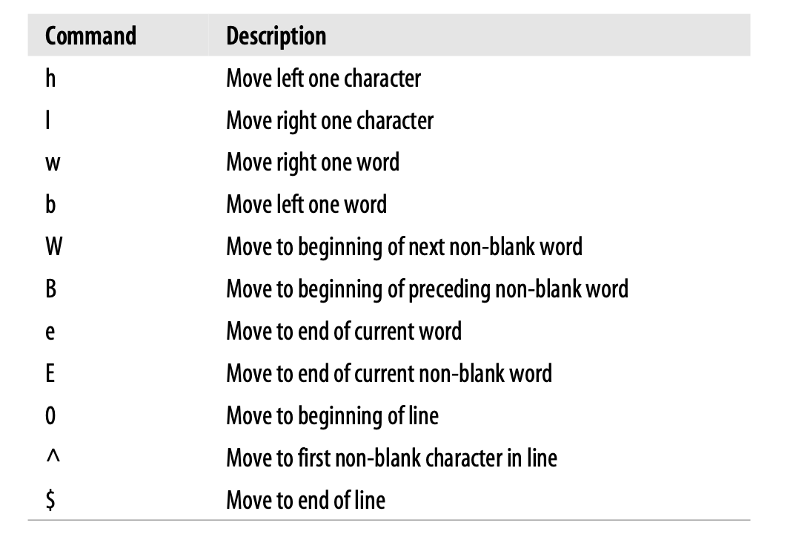
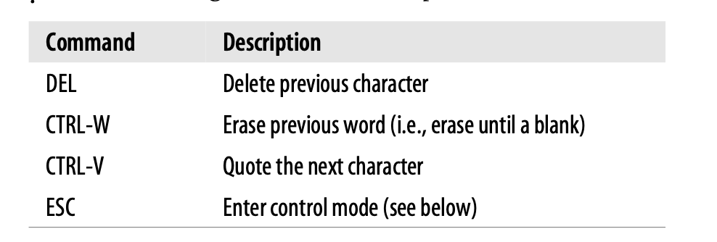
vi Editing Mode
vi mode is popular because vi is the most standard UNIX editor.
A list of essential commands is mentioned below:

Slide 7
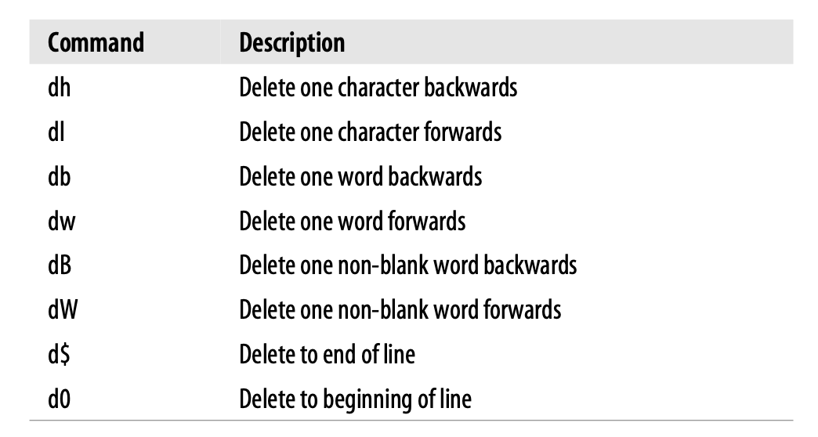
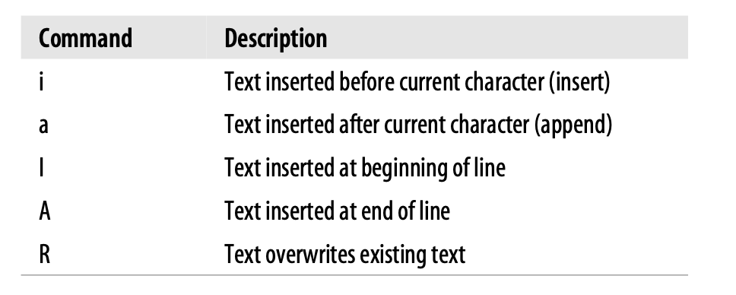
vi Editing Mode
List of commands continued :

Slide 8
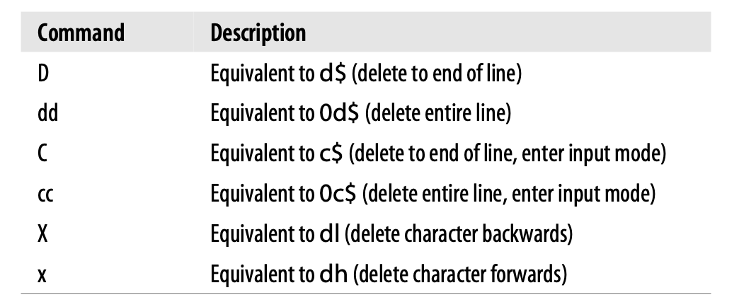
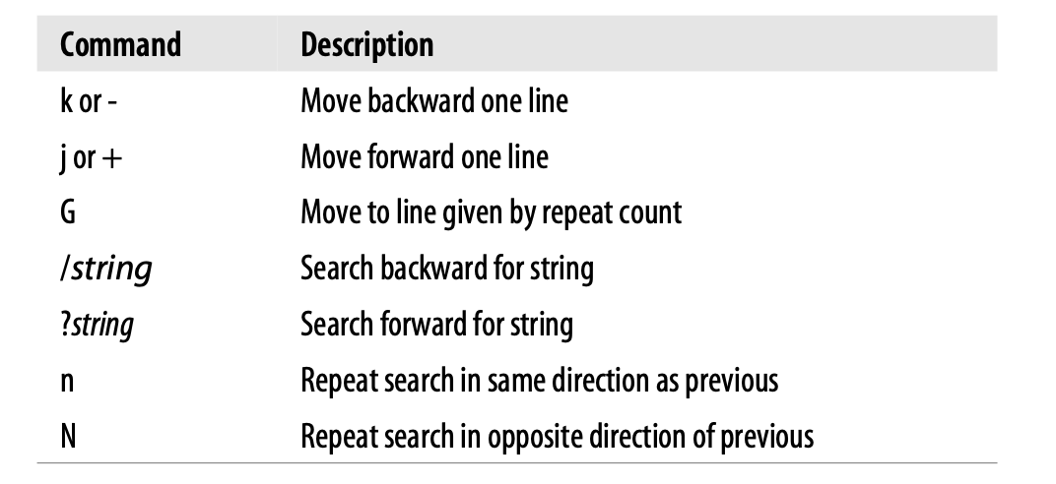
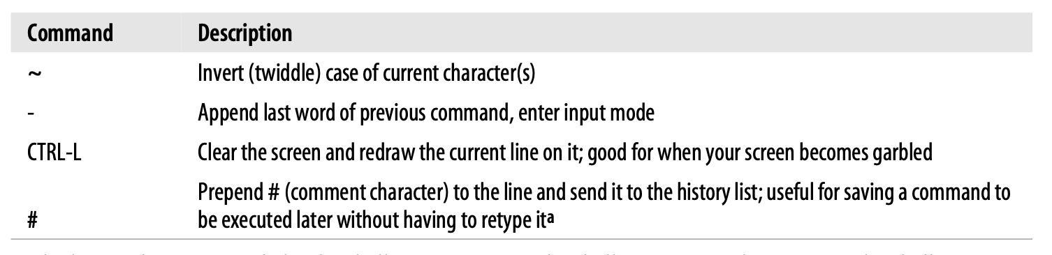
vi Editing Mode
List of commands continued :

Slide 9
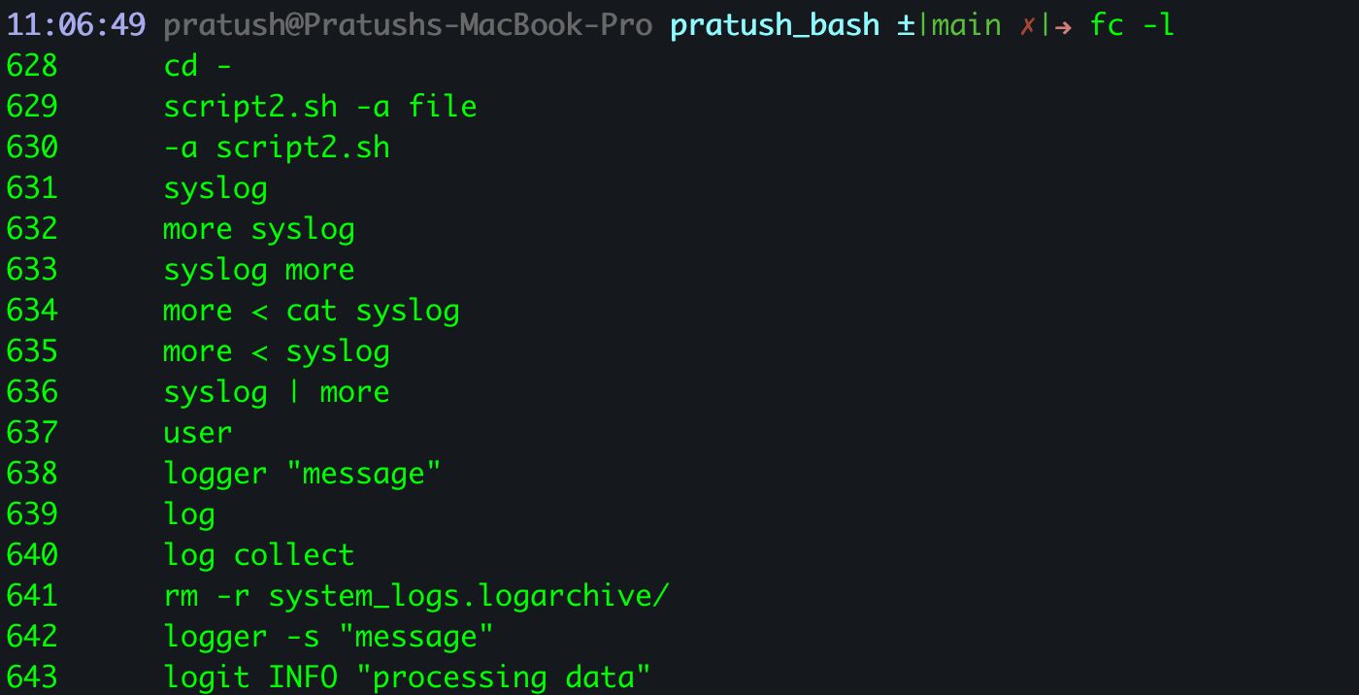
The fc Command
fc is a built-in shell command that provides a superset of the C shell history mechanism.
The -l option to fc lists previous commands.
If two commands are given, they serve first and last commands to be shown.
If a single string argument is used, it shows the most recent command starting with that string.
If no arguments are used, it returns your last 16 commands.

Slide 10
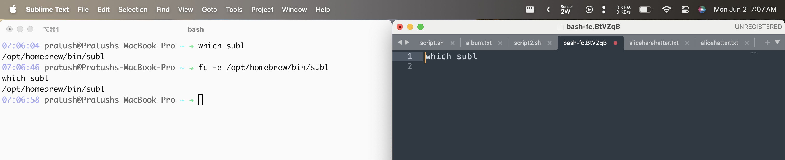
The fc Command
To use your prefered editor for editing commands use :
fc -e {PATH to your prefered editor}
fc -s allows you to rerun a command. With an argument, fc will rerun the last command starting with the given string.

Slide 11
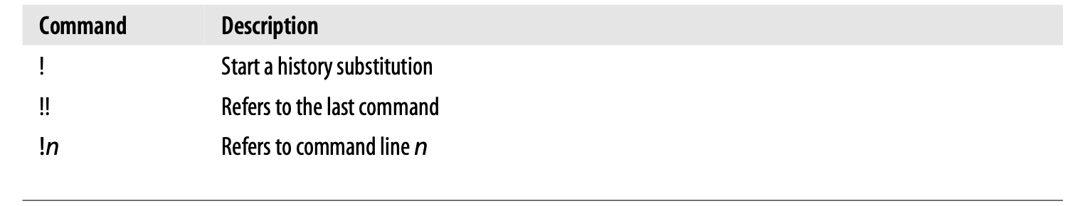
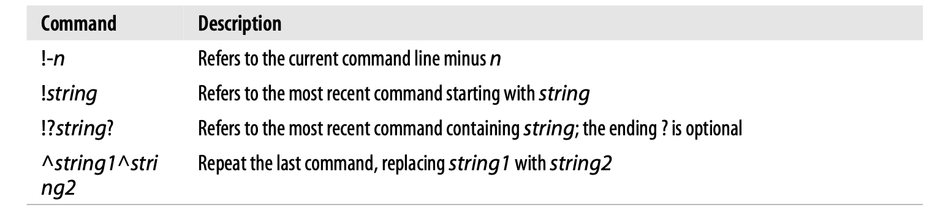
History Expansion

Slide 12
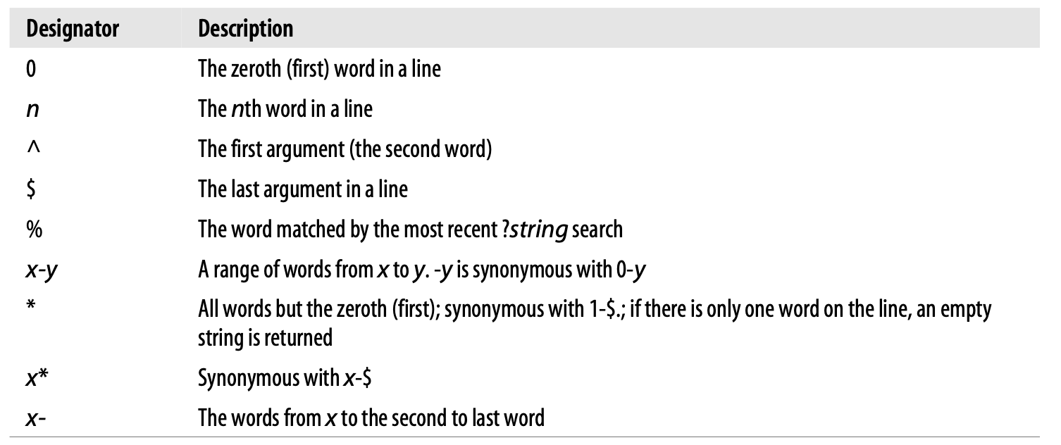
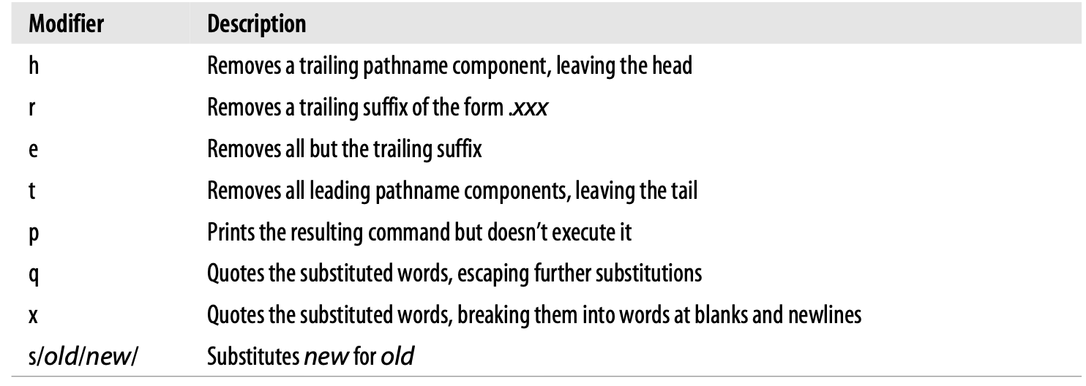
History Expansion

Slide 13
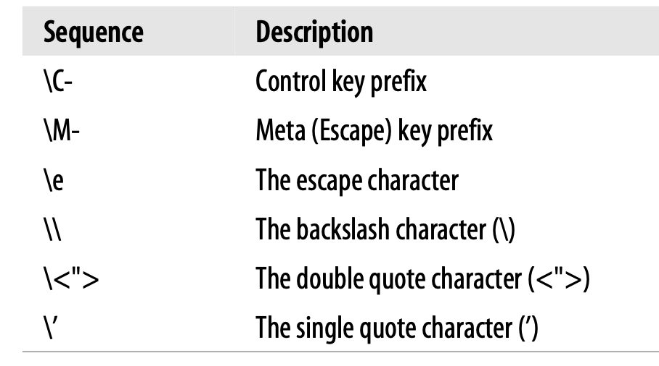
readline
bash’s command-line editing interface is readline.
readline provides default editing in either of two modes: vi or emacs. Both modes provide a subset of the editing commands found in the full editors.
readline gives bash added flexibility compared to other shells because it can be customized through the use of keybindings, either from the command line or in a special startup file. You can also set readline variables.
The default startup file is called .inputrc and must exist in your home directory.
When bash starts up, it reads the startup file (if there is one) and any settings there come in to effect.

Slide 14
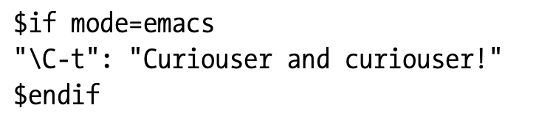
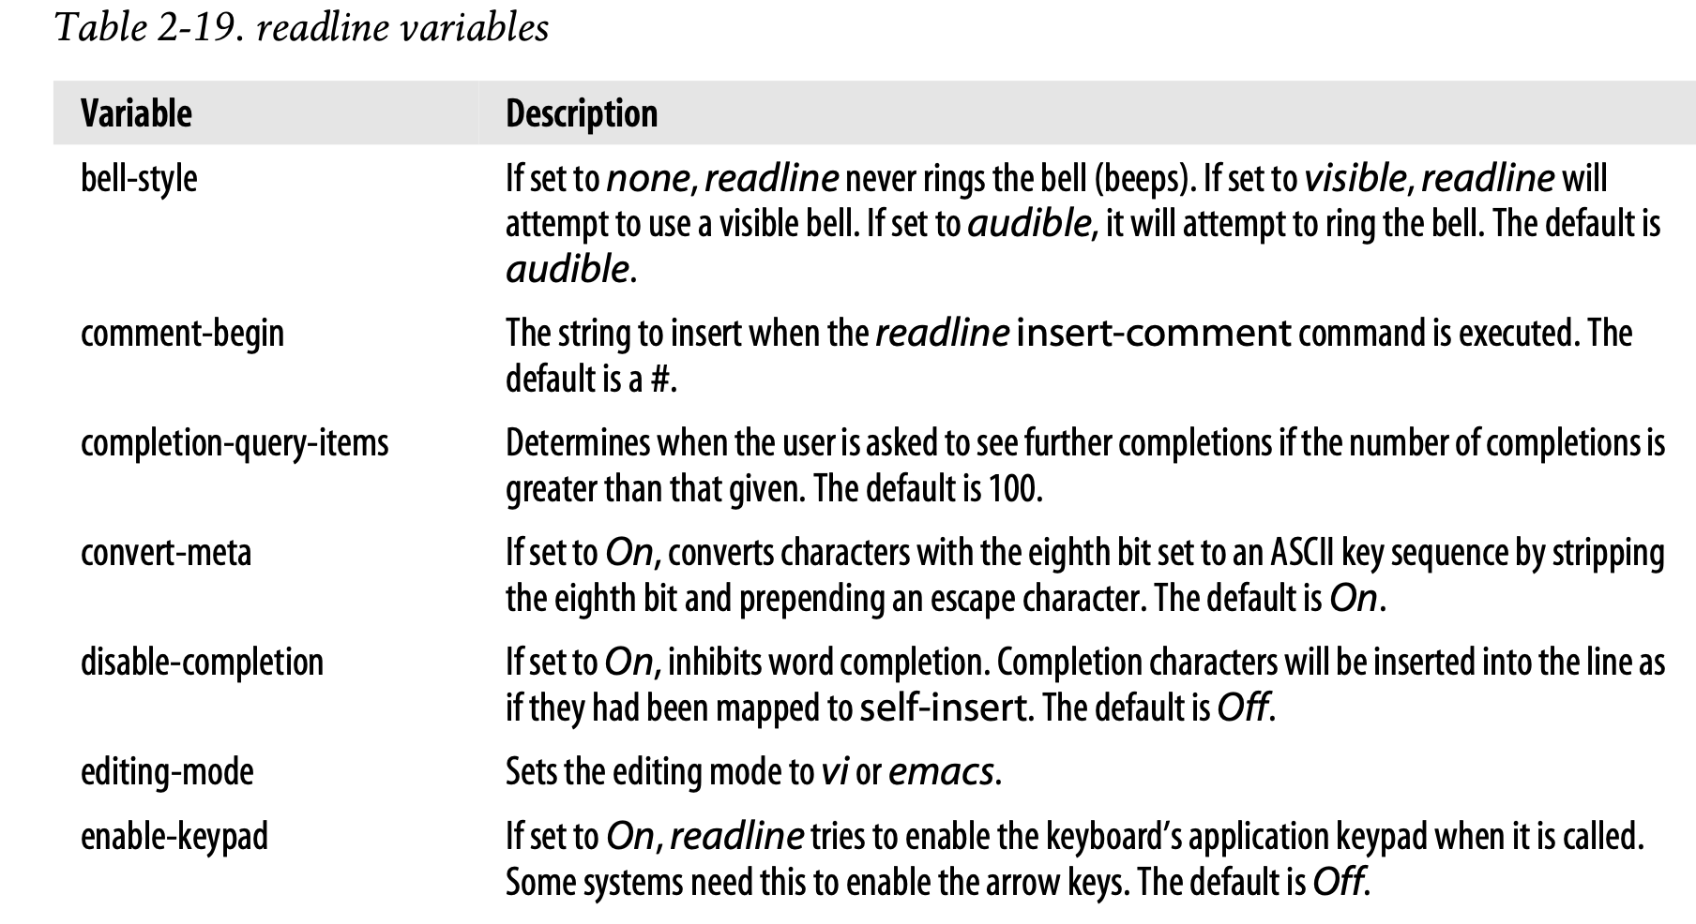
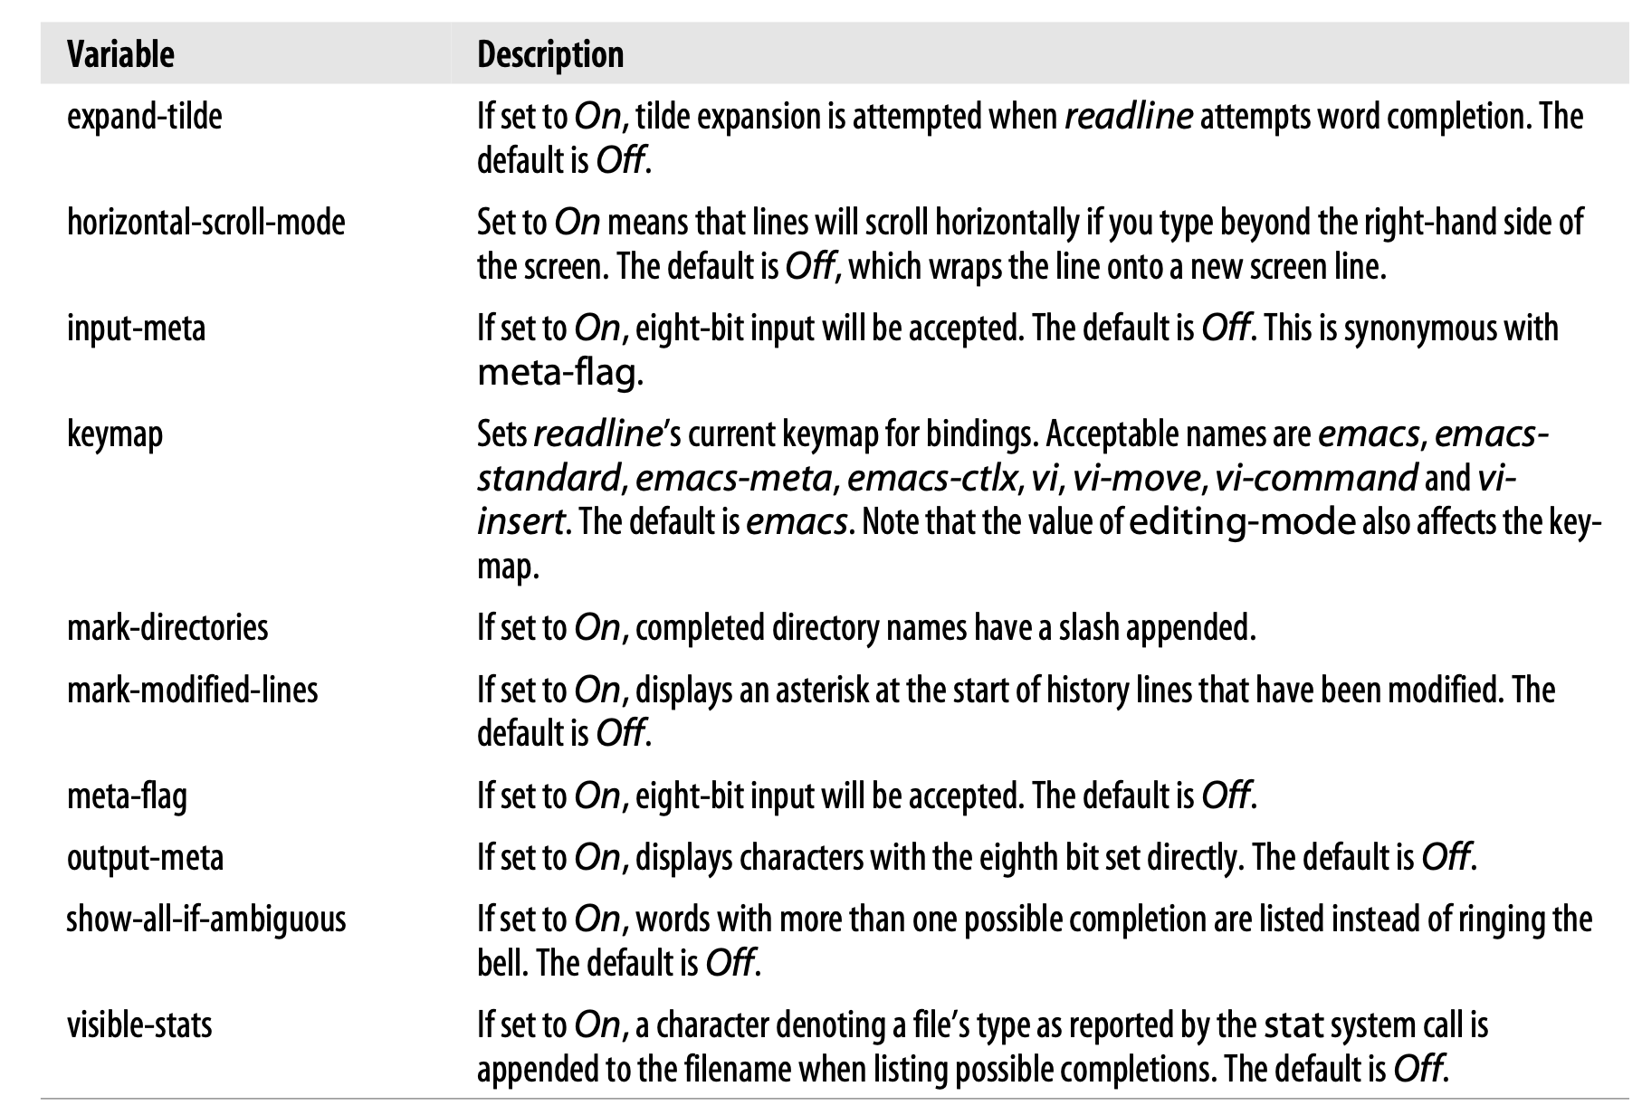
readline
readline also allows simple conditionals in the .inputrc. There are three directives:
$if, $else, and $endif.The conditional of the $if can be an editing mode, a terminal type, or an application-specific condition.
To test for bash specifics, you could put $if bash into your .inputrc. (keeps your bash-specific bindings separate.)

Slide 15
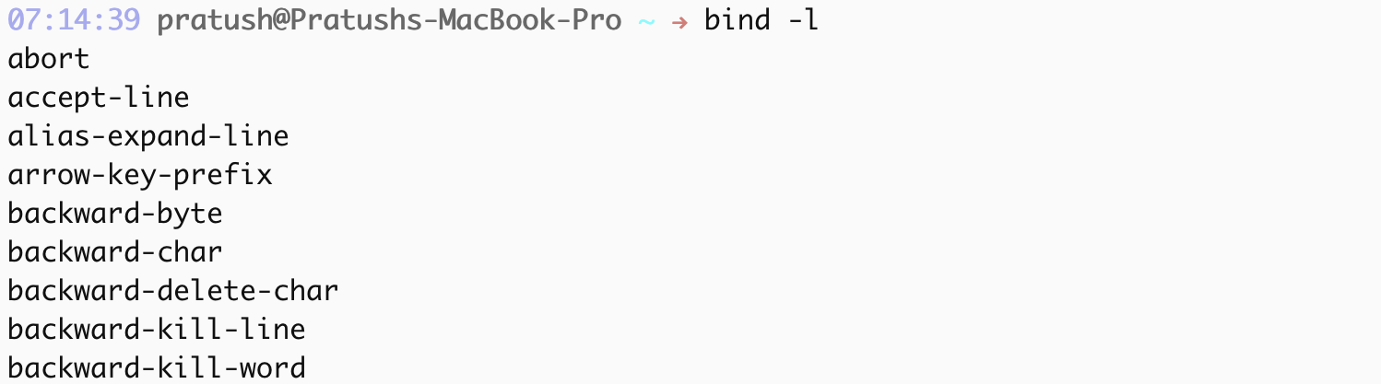
readline
If you want to try out keybindings or you want to see what the current settings are, you can do it from the bash command line by using the bind command.
bind -l shows the readline functions.
unbind a function using: bind -u
unbind a key sequence using: bind -r
bind a shell command to a key sequence using: bind -x
to create a complete .inputrc file that you can then edit, you could type: bind -p > .inputrc. (bind -p prints to the standard output in a form which can be reread by bind)

Slide 16
Keyboard habits
bash provides command-line editing with two modes: vi and emacs. You may be wondering why these two editors were chosen. The primary reason is because vi and emacs are the most widely used editors for UNIX.
Both bash editing modes have quite a few commands; you will undoubtedly develop keyboard habits that include just a few of them.
a vi user has the power to move mountains in few keystrokes—but at the cost of being unable to do anything meaningful in very few keystrokes.

Slide 17
THANK YOU

